Slide 1
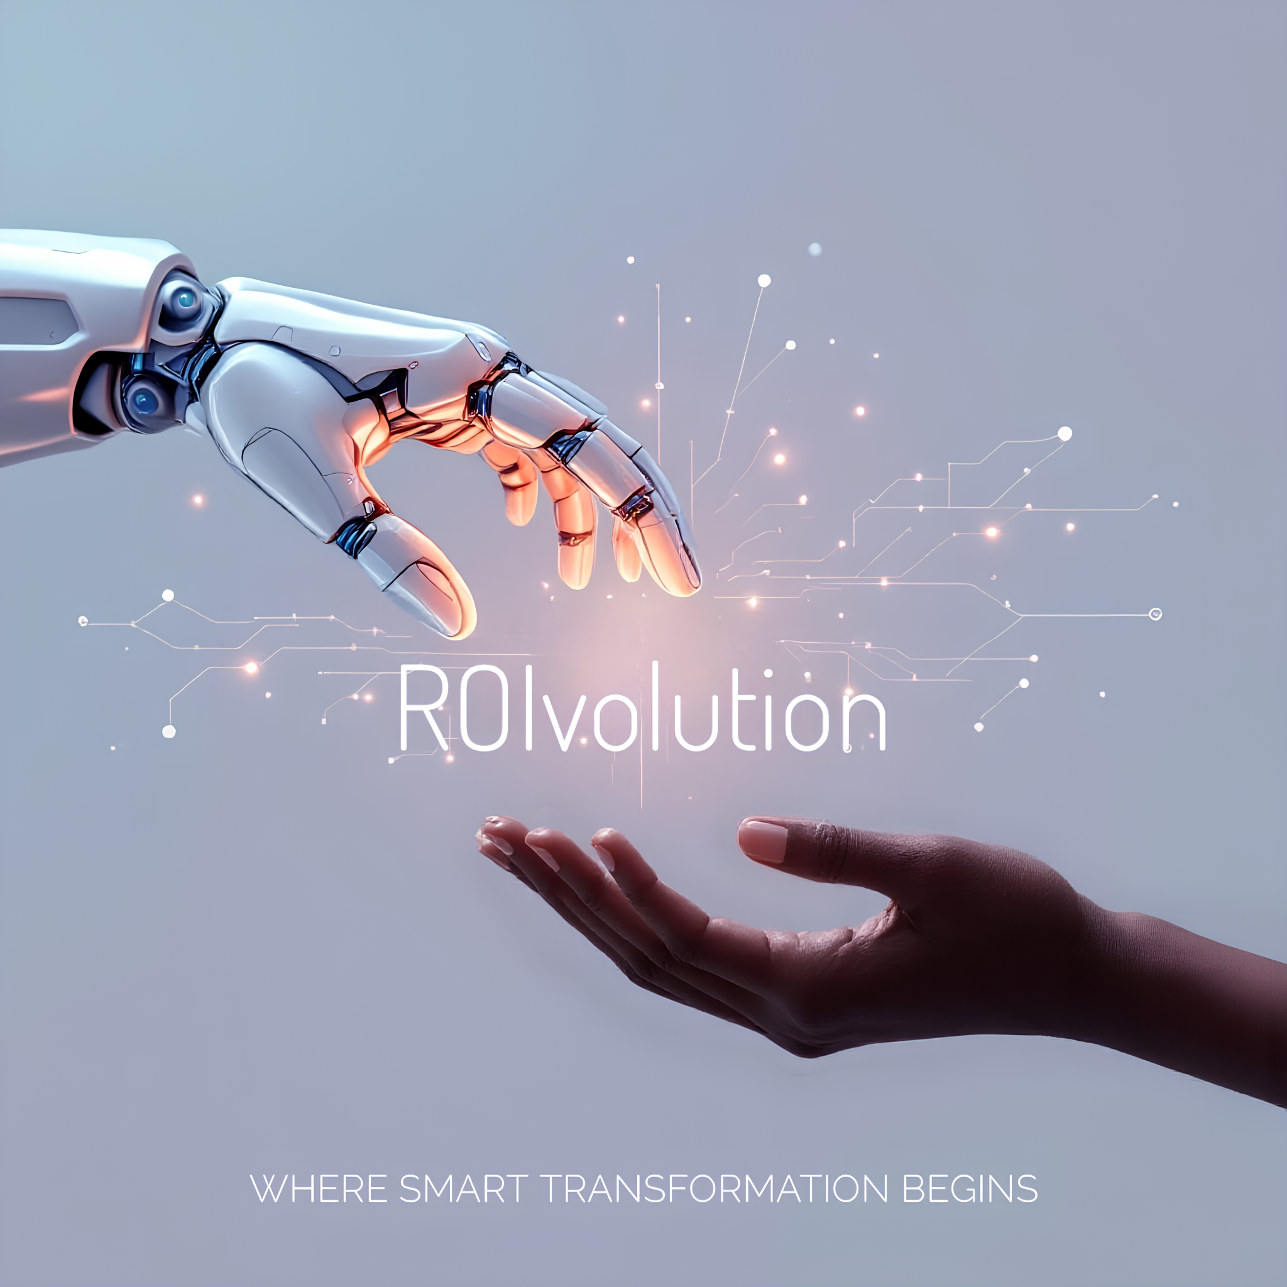
Prototyping Presentation
The best marketing tool for your business.

Slide 2

TOC
Introducing: ROIvolution
Overview
Understanding the problems
Project Goals
Introducing: ROIvolution
Key Learnings
Thank You

Slide 3
Overview
ROIvolution is an AI-powered predictive analytics platform designed to address the critical challenge that approximately 70% of organizational transformation initiatives fail. The solution helps business leaders quantify, visualize, and optimize change initiatives through data-driven insights and predictive modeling, ultimately improving success rates for transformation projects.
The platform leverages multiple Azure services to provide organizations with real-time metrics, forecasting capabilities, and strategic recommendations. At its core, ROIvolution enables decision-makers to visualize potential outcomes, identify risks, and implement strategies that convert typical failure scenarios into successful transformations.

Slide 4
Understanding the problems
01
The challenge is to build an ROI calculator to help leaders prepare for change with predictive insights, actionable recommendations for change initiatives, visualizations and reporting, while considering financial risks of project failure, employee disengagement, and potential savings from improved productivity.
02
AI-Driven Anomaly Detection in Transformation Projects: The platform appears to incorporate AI anomaly detection capabilities (as seen in the screenshots) to identify unusual patterns or outliers in transformation data. This helps organizations detect potential risks or issues in real-time before they escalate into project failures, allowing for proactive intervention instead of reactive crisis management.
Industry-Specific Benchmarking and Best Practices: Based on the "Industry Types" configuration screen, the platform seems designed to gather and analyze transformation data across different sectors (Finance, Retail, Education, Health). This enables cross-industry benchmarking, allowing organizations to compare their transformation initiatives against relevant peers and adopt proven best practices specific to their industry, rather than applying generic approaches.
03

Slide 5
Project Goals
Our primary goal with ROIvolution is to disrupt the 70% failure rate of transformation initiatives by creating an AI-powered platform that enables leaders to make data-driven decisions throughout the change process.
Core Objectives
1.Reduce Transformation Failure Rate
2. Enable Data-Driven Decision Making
3. Visualize Transformation Outcomes
4. Optimize Resource Allocation
5.Democratize Transformation Intelligence
6. Promote Responsible Change Management

Slide 6
Introducing: ROIvolution
ROIvolution features a modern, cloud-based architecture with four main layers:
1.User Interface Layer:
-Next.js and TypeScrip
2.System Logic Layer
-Frontend: Next.js and TypeScript
-Backend: Python deployed via Azure Functions
3. Storage Layer: Azure Blob Storage
4. Azure AI Services Layer
-Anomaly detection

Slide 7
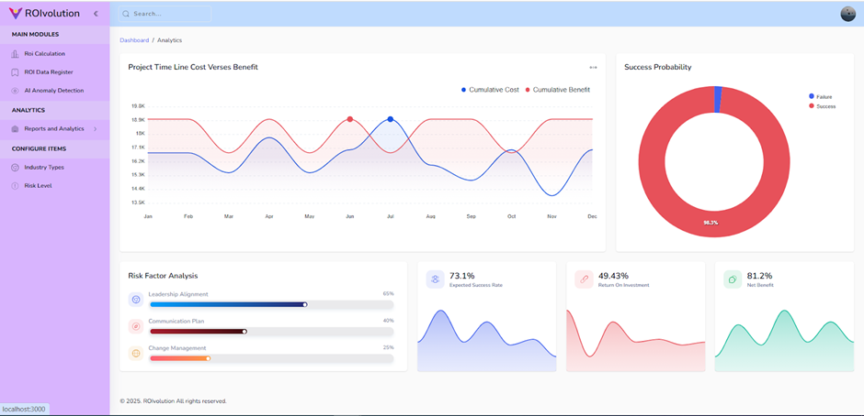

Slide 8
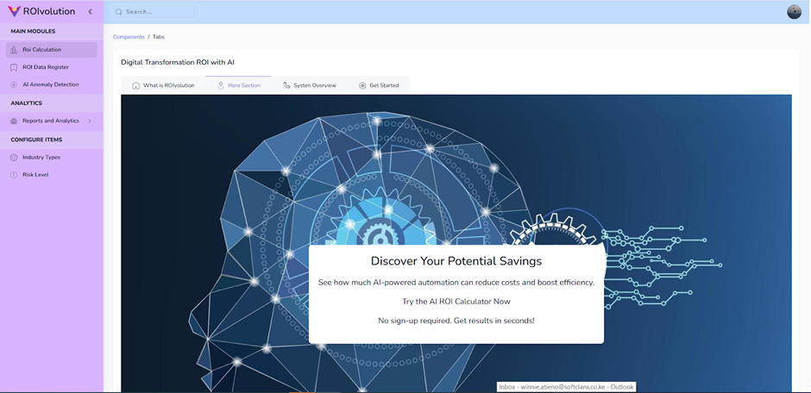

Slide 9
Through developing ROIvolution, we gained several valuable insights:
The complexity of quantifying transformation success requires multidimensional analysis - no single metric can capture the full picture.
Employee engagement metrics are as important as financial indicators in predicting transformation success.
Visualization is critical for making complex transformation data accessible to stakeholders across the organization.
The system architecture needed to balance simplicity for the hackathon demonstration with scalability for potential real-world implementation.
Azure's AI services provide powerful capabilities that can transform raw project data into meaningful insights, especially when integrated effectively.
Key Learnings

Slide 10
Thank you! Microsoft Innovation Ai Challenge March 2025
Presented by:
Winnie Atieno and Shakera Karolia

